Slide 1
Cloud Computing and Web Services
Suozhi (James) Qi
04/18/17

Slide 2
Storing and accessing data and programs over the Internet instead of one’s own computer’s hard drive
https://en.wikipedia.org/wiki/Cloud_computing
Notes:
Cloud computing metaphor: For a user, the network elements representing the provider-rendered services are invisible, as if obscured by a cloud
No need to set up one’s own storage, server and data center. Gain unlimited computing sources from the Internet.

Slide 3
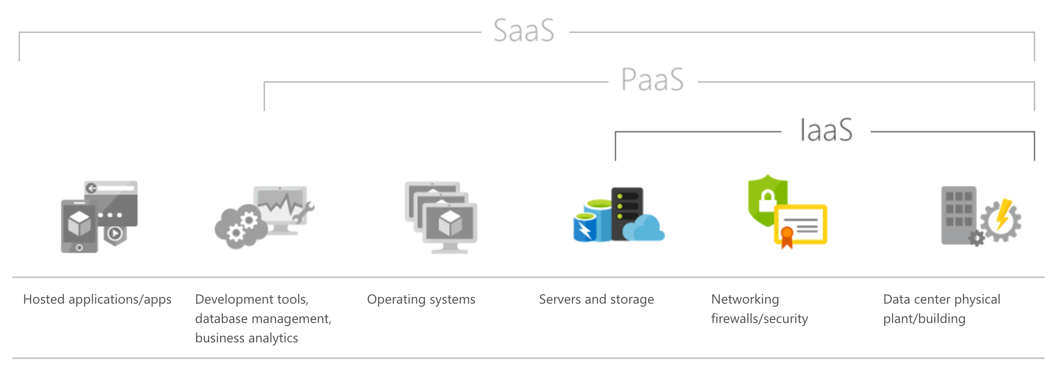
Layers of cloud computing services
Notes:
IaaS: physical servers and data center are provided by an external provider and managed for the user
Provider: AWS
PaaS: users get a layer of operating system and development tool
Provider: Apprenda
SaaS: everything from storage, data center, servers to middleware and finally to applications
Provider: Adobe, Oracle

Slide 4
Notes:
Private cloud: the highest degree of control, lowest scalability
The users to buy, build and maintain the whole set of data center and services, but it is more secure when compared with public cloud system.
Public: the opposite
cloud services are rendered over a network for public usage.
Public service providers include Amazon Web Services, Microsoft and Google allow users to access and enjoy their services via the Internet

Slide 5
Advantages:
Save money and time
Any where, any time (Google drive, google docs, etc)
Great scalability
Disadvantages:
Security (Dropbox, breach, 2014, 7 million user info leaked)
Copyright (your data or the service provider’s data?)

Slide 6
For web developers:
Access to apps and data on cloud servers
Host our own apps using cloud components
Synchronize our projects using cloud services (google docs, github)
Be aware of the potential security and copyright problems when using public cloud services

